Slide 1
Working with Python Date & Time
By Nimesh Kumar Dagur

Slide 2
Working with Date & Time
A Python program can handle date and time in several ways.
Converting between date formats is a common task for computers.
Python's datetime and time modules help track dates and times.

Slide 3
Date and time: datetime
The datetime module provides us with objects which we can use to store information about dates and times:
datetime.date is used to create dates which are not associated with a time.
datetime.time is used for times which are independent of a date.
datetime.datetime is used for objects which have both a date and a time.
datetime.timedelta objects store differences between dates or datetimes – if we subtract one datetime from another, the result will be a timedelta.
We can query these objects for a particular component (like the year, month, hour or minute), perform arithmetic on them, and extract printable string versions from them if we need to display them.

Slide 4
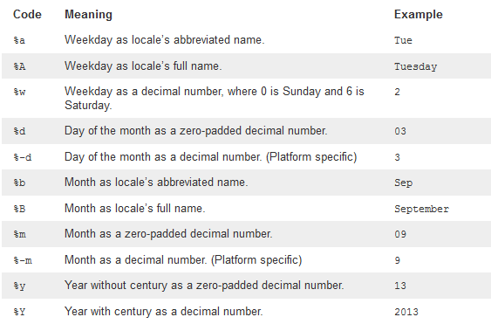
Date Formats: strftime
Examples are based on datetime.datetime(2013, 9, 3, 9, 6, 5)

Slide 5
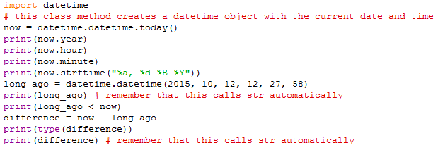
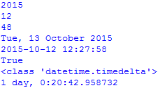
Date and time: datetime Example

Slide 6
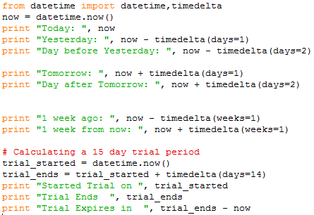
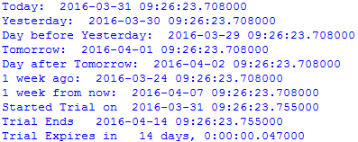

Slide 7
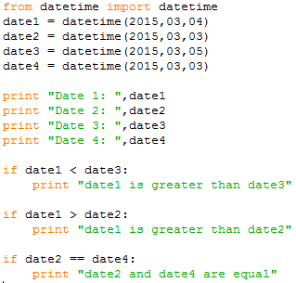
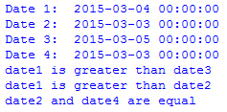
Date Comparison in python

Slide 8
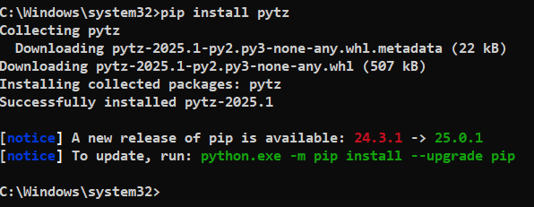

Slide 9
time module
There is a time module available in Python which provides functions for working with times, and for converting between representations.
The function time.time() returns the current system time in ticks since 12:00am, January 1, 1970.

Slide 10
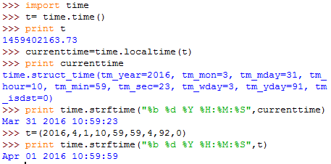
time module

Slide 11
Python Namespace and Scope
If you have ever read 'The Zen of Python' (type "import this" in Python interpreter), the last line states, Namespaces are one honking great idea -- let's do more of those! So what are these mysterious namespaces? Let us first look at what name is.
Name (also called identifier) is simply a name given to objects.
Everything in Python is an object.
Name is a way to access the underlying object.
Example:
a = 2,
here 2 is an object stored in memory and a is the name we associate it with. We can get the address (in RAM) of some object through the built-in function, id().

Slide 12

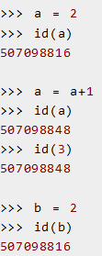
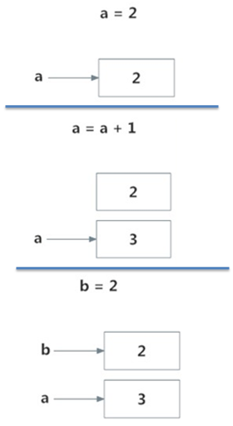
Python Name
Initially, an object 2 is created and the name a is associated with it, when we do a = a+1, a new object 3 is created and now a associates with this object. Note that id(a) and id(3) have same values. Furthermore, when we do b = 2, the new name b gets associated with the previous object 2.
This is efficient as Python doesn't have to create a new duplicate object.
This dynamic nature of name binding makes Python powerful; a name could refer to
any type of object.

Slide 13

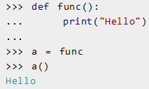
All these are valid and a will refer to three different types of object at different instances.
Functions are objects too, so a name can refer to them as well.
Our same name a can refer to a function and we can call the function through it, pretty neat.

Slide 14
Namespace
Namespace is a collection of names.
In Python, you can imagine a namespace as a mapping of every name, you have defined, to corresponding objects.
Different namespaces can co-exist at a given time but are completely isolated.
A namespace containing all the built-in names is created when we start the Python interpreter and exists as long we don't exit.
This is the reason that built-in functions like id(), print() etc. are always available to us from any part of the program.

Slide 15
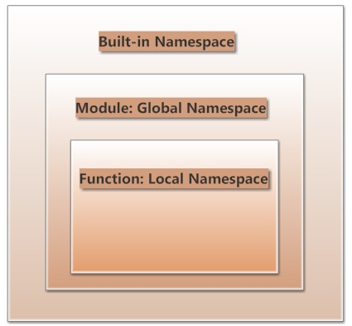
Each module creates its own global namespace.
Since, these different namespaces are isolated, same name that may exist in different modules do not collide.
Modules can have various functions and classes.
A local namespace is created when a functions is called, which has all the names defined in it.
Similar, is the case with class

Slide 16
Python Scope
Although there are various unique namespaces defined, we may not be able to access all of them from every part of the program.
The concept of scope comes into play.
Scope is the portion of the program from where a namespace can be accessed directly without any prefix.
At any given moment, there are at least three nested scopes.
Scope of the current function which has local names
Scope of the module which has global names
Outermost scope which has built-in names

Slide 17
When a reference is made inside a function, the name is searched in the local namespace, then in the global namespace and finally in the built-in namespace.
If there is a function inside another function, a new scope is nested inside the local scope.

Slide 18
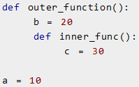
Example of Scope and Namespace in Python
Here, the variable a is in the global namespace. Variable b is in the local namespace of outer_function() and c is in the nested local namespace of inner_function().
When we are in inner_function(), c is local to us, b is nonlocal and a is global. We can read as well as assign new values to c but can only read b and c from inner_function().
If we try to assign as a value to b, a new variable b is created in the local namespace which is different than the nonlocal b. Same thing happens when we assign a value to a.

Slide 19
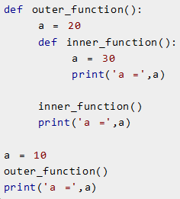
Example of Scope and Namespace in Python
a=
a=
a=
a=
a=
a=
If we declare a as global, all the reference and assignment go to the global a.
In this program, three different variables a are defined in separate namespaces and accessed accordingly.

Slide 20
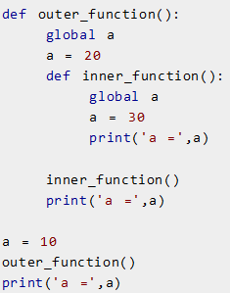
Here, all reference and assignment are to the global a due to the use of keyword global.

Slide 21
Python Objects and Class
- By Nimesh Kumar Dagur,CDAC Noida, India

Slide 22
Python Objects and Class
Python is an object oriented programming language.
Unlike procedure oriented programming, in which the main emphasis is on functions, object oriented programming stress on objects.
Object is simply a collection of data (variables) and methods (functions) that act on those data.
Class is a blueprint for the object.
We can think of class like a sketch (prototype) of a house.
It contains all the details about the floors, doors, windows etc.
Based on these descriptions we build the house.
House is the object.
As, many houses can be made from a description, we can create many objects from a class.
An object is also called an instance of a class and the process of creating this object is called instantiation

Slide 23
Object 1
Name: Abhishek
Sex: Male
Profession: engineer
Work(): works as engineer in xyz company
Study(): study 15 hrs a week
Class : Person
state
Name
Sex
Profession
Object 2
behavior
Name: Abhishikha
Sex: Female
Profession: doctor
Work()
Study()
Work(): works as doctor in xyz hospital
Study(): study 17 hrs a week

Slide 24

Defining a Class in Python
Like function definitions begin with the keyword def, in Python, we define a class using the keyword class.
The first string is called docstring and has a brief description about the class.
Although not mandatory, this is recommended.
Class definition:

Slide 25
A class creates a new local namespace where all its attributes are defines.
Attributes may be data or functions.
There are also special attributes in it that begins with double underscores (__).
For example, __doc__ gives us the docstring of that class.
As soon as we define a class, a new class object is created with the same name.
This class object allows us to access the different attributes as well as to instantiate new objects of that class.

Slide 26
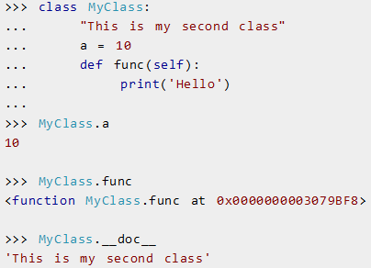

Slide 27
Creating an Object in Python
Class object could be used to access different attributes.
It can also be used to create new object instances (instantiation) of that class.
The procedure to create an object is similar to a function call.
This will create a new instance object named ob.
We can access attributes of objects using the object name prefix.
Attributes may be data or method.
Method of an object are corresponding functions of that class.
Any function object that is a class attribute defines a method for objects of that class.
This means to say, since MyClass.func is a function, ob.func will be a method object.

Slide 28
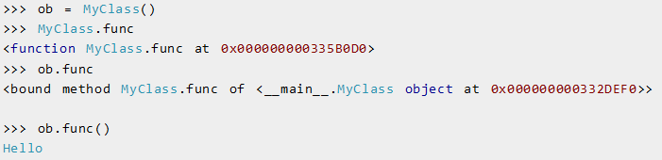
MyClass.func(ob)

Slide 29
You may have notices the self parameter in function definition inside the class.
But we called the method simply as ob.func() without any arguments. It still worked.
This is because, whenever an object calls its method, the object itself is pass as the first argument.
So, ob.func() translates into MyClass.func(ob).
In general, calling a method with a list of n arguments is equivalent to calling the corresponding function with an argument list that is created by inserting the method's object before the first argument.
For these reasons, the first argument of the function in class must be the object itself.
This is conventionally called self.
It can be named otherwise but we highly recommend to follow the convention.

Slide 30
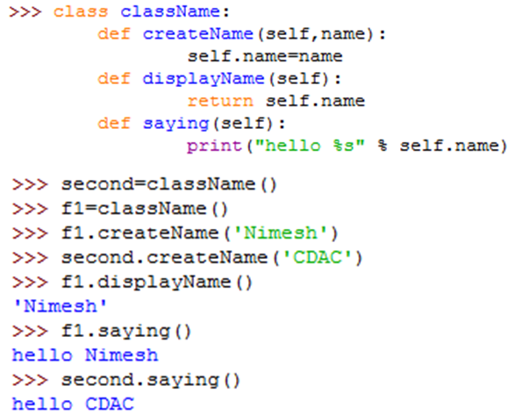

Slide 31
Constructors in Python
Class functions that begins with double underscore (__) are called special functions as they have special meaning.
Of one particular interest is the __init__() function.
This special function gets called whenever a new object of that class is instantiated.
This type of function is also called constructors in Object Oriented Programming (OOP).
We normally use it to initialize all the variables.

Slide 32
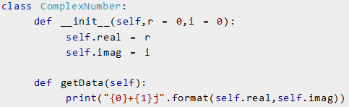
Constructors in Python
In the above example, we define a new class to represent complex numbers.
It has two functions, __init__() to initialize the variables (defaults to zero) and getData() to display the number properly.

Slide 33
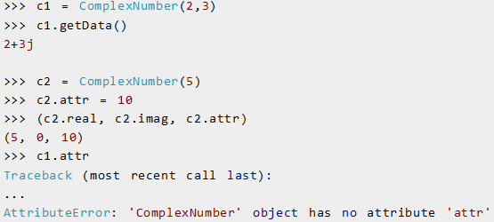
An interesting thing to note in the above step is that attributes of an object can be created on the fly.
We created a new attribute attr for object c2 and we read it as well.
But this did not create that attribute for object c1

Slide 34
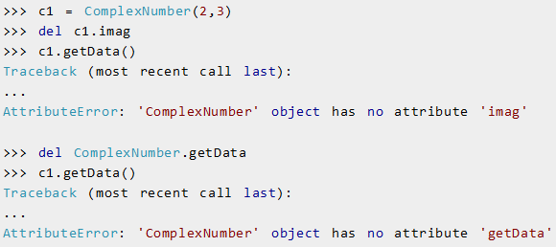
Deleting Attributes and Objects
Any attribute of an object can be deleted anytime, using the del statement.

Slide 35
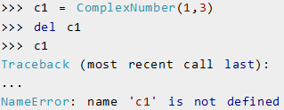
Deleting Attributes and Objects
We can even delete the object itself, using the del statement

Slide 36
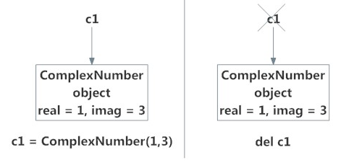
Deleting Attributes and Objects
When we do c1 = ComplexNumber(1,3), a new instance object is created in memory and the name c1 binds with it.
On the command del c1, this binding is removed and the name c1 is deleted from the corresponding namespace.
The object however continues to exist in memory and if no other name is bound to it, it is later automatically destroyed.
This automatic destruction of unreferenced objects in Python is also called garbage collection.

Slide 37
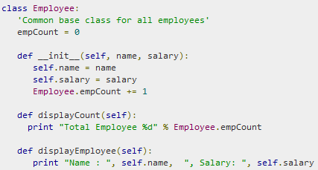
Example
The variable empCount is a class variable whose value is shared among all instances of a this class.
The first method __init__() is a special method, which is called class constructor or initialization method that Python calls when you create a new instance of this class.
You declare other class methods like normal functions with the exception that the first argument to each method is self.
Python adds the self argument to the list for you; you do not need to include it when you call the methods.

Slide 38
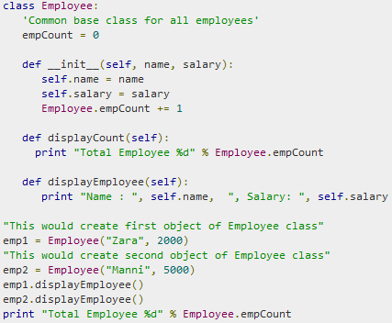


Slide 39

You can add, remove, or modify attributes of classes and objects at any time.

Slide 40
